Slide 1
Time Complexity Intro to Searching
CS221 – 2/20/09

Slide 2
Complexity
Measures
Implementation complexity (Cyclomatic)
Time complexity (Big O)
Space complexity (Also Big O)
Trade off examples
Simple to implement algorithm may have high time complexity
Fast insertion may require additional space
Reducing space may require additional time

Slide 3
Why is it Important?
Allows you to see when an algorithm is untenable
Allows you to compare competing algorithms and data structures
Saves you from hitting dead-ends
Allows you to estimate processor and storage load with increasing usage
Tells you where to look when making performance improvements
Allows you to make the right tradeoffs
Implementation time
Maintainability
Time to execute/responsiveness
Memory/Disk storage requirements

Slide 4
Time Complexity
Measures how many computational steps in relation to input
As the input set increases, how much impact on computation time?

Slide 5
Space Complexity
Measures how much storage in relation to input
As the input set increases, how much impact on storage requirements?

Slide 6
Big O Notation
O(1) – Constant. Very Nice!
O(log n) – Logarithmic. Nice!
O(n) – Linear. Good!
O(n log n) – Log-linear. Not Bad.
O(n^2) – Quadratic. Getting expensive.
O(n^3) – Cubic. Expensive.
O(2^n) – Exponential. Ouch!
O(n!) – Factorial. Holy Moly!!

Slide 7
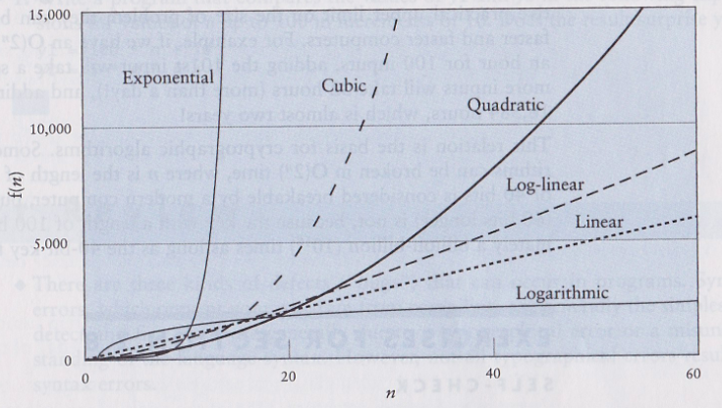
Big O Notation

Slide 8
Cryptography
Cracking modern cryptographic algorithm = O(2^n)
40 bit key: Brute force attack in a couple of days
128 bit key: Brute force attack in 8.48E20 Millennia
Brute force is clearly not the way to go!
People crack crypto by:
Finding mistakes in the algorithm
Distributed computing
Stealing the keys
Advanced mathematical techniques to reduce the search space
Cryptography has a surprising property – the more people who know the algorithm, the safer you are.

Slide 9
How to Calculate
Informal method…
Look at the algorithm to understand loops, recursion, and simple statements
No loops, size of input has no impact = O(1)
Iterative partition (cut in half) = O(log n)
For loop = 0(n)
Nested for loop = O(n^2)
Doubly nested for loop = O(n^3)
Recursively nested loops = O(2^n)
Reduce to the largest O measure
Discrete Mathematics covers formal proofs

Slide 10
O(1) Example
Public void setFlightNode(int location, FlightNode flightNode)
{
flightArray[location] = flightNode;
}

Slide 11
O(log n) Example
public static int binarySearch(int[] list, int listLength, int searchItem)
{
int first=0;
int last = listLength - 1;
int mid;
boolean found = false;
//Loop until found or end of list.
while(first <= last &&!found)
{
//Find the middle.
mid = (first + last) /2;
//Compare the middle item to the search item.
if(list[mid] == searchItem) found = true;
else
{ //Halve the size & start over.
if(list[mid] > searchItem)
{
last = mid - 1;
}
else
{
first = mid + 1;
}
}
}
if(found)
{
return mid;
}
else
{
return(-1);
}

Slide 12
O(n) Example
for (int i; i < n; i++)
{
//do something
}

Slide 13
O(n^2) Example
for (int i; i < n; i++)
{
for (int j; j < n; j++)
{
//do something
}
}

Slide 14
O(n^3) Example
for (int i; i < n; i++)
{
for (int j; j < n; j++)
{
for (int k; k < n; j++)
{
//do something
}
}
}

Slide 15
O(2^n) Example
public void PrintPermutations(int array[], int n, int i)
{
int j;
int swap;
for(j = i+1; j < n; j++)
{
swap = array[i];
array[i] = array[j];
array[j] = swap;
PrintPermutations(array, n, i+1);
swap = array[i];
array[i] = array[j];
array[j] = swap;
}
}

Slide 16
Worst-Average-Best
When considering an algorithm
What is the worst case?
What is the average case?
What is the best case?

Slide 17
Example
Find an item in a linked list
Best case? Average Case? Worst case?
Find an item in an array
Best case? Average case? Worst case?
Add an item to a linked list
Best case? Average case? Worst case?
Add an item to an array
Best case? Average case? Worst case?
Delete an item from a linked list
Best case? Average case? Worst case?
Delete an item from an array
Best case? Average case? Worst case?

Slide 18
Data Structure Analysis
FlightNode flightArray[] = new FlightNode[numFlights];
Array vs. Linked List
What are the key differences?
Why choose one vs. the other?
Think about:
Complexity
Implementation complexity
Time complexity
Space complexity
Operations (CRUD)
Create an item
Read (access) an item
Update an item
Delete an item

Slide 19
Data Structure Analysis
Singly linked-list vs. doubly-linked list
Time complexity?
Space complexity?
Implementation complexity?

Slide 20
Tangential Questions
Stack vs. Heap
What’s the difference?
How do you know which you are using?
How does it relate to primitive types vs. objects?
Should you care?

Slide 21
Intro to Search
Search algorithm: Given a search key and search space, returns a search result
Search space: All possible solutions to the search
Search key: The attribute we are searching for
Search result: The search solution

Slide 22
Search
Many, if not most, problems in Computer Science boil down to search
Recognizable examples:
Chess
Google map directions
Google in general!
Authentication and authorization
UPS delivery routes

Slide 23
Search Types
Types of search algorithms
Depth first
Breadth first
Graph traversal
Shortest path
Linear search
Binary search
Minmax
Alpha-beta pruning
Combinitorics
Genetic algorithms
You will probably implement all of these by the time you graduate

Slide 24
Searching and Sorting
The purpose of sorting is to optimize your search space for searching
Sorting is expensive but it is a one-time cost
A random data-set requires brute-force searching O(n)
A sorted data-set allows for a better approach O(log n)
For example:
Binary search requires a sorted data-set to work
Binary search tree builds sorting directly into the data structure

Slide 25
Search Examples
In Scope:
List Search: Linear Search, Binary Search
Covered in later classes:
Tree Search: Search through structured data
Graph Search: Search using graph theory
Adversarial Search: Game theory

Slide 26
List Search Algorithms
Linear Search: Simple search through unsorted data. Time complexity = O(n)
Binary Search: Fast search through sorted data. Time complexity = O(log n)

Slide 27
How to Choose?
When is linear search the optimal choice?
When is binary search the optimal choice?
Think about how you will be using and modifying the data…

Slide 28
How to Implement Linear Search
Take a data-set to search and a key to search for
Iterate through the data set
Test each item to see if it equals your key
If it does, return true
If you exit the iteration without the item, return false

Slide 29
How to Implement: Linear Search
public Boolean LinearSearch(int dataSet[], int key)
{
for (int i = 0; i < dataSet.length; i++)
{
if (dataSet[i] == key)
{
return true;
}
}
return false;
}

Slide 30
Search Keys
Generally, search key and search result are not the same
Consider:
Search for a business by address
Search for a passenger by last name
Search for a bank account by social security #

Slide 31
Search Keys
How would the search change if the key is not the result?

Slide 32
Linear Search
public Customer LinearSearch(Customer customers[], String socialSecurity)
{
for (int i = 0; i < customers.length; i++)
{
if (customers[i].getSocialSecurity() == key)
{
return customers[i];
}
}
Throw new CustomerNotFoundException(“Social Security Number doesn’t match a customer”);
}

